Slide 1
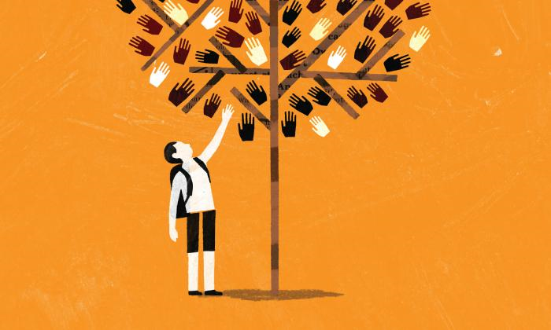
Tolerance:
philosophical aspects

Slide 2
Problem I.
It says about some people: «They are tolerant”, but about others: “They are intolerant”.
What is the meaning of “To be tolerant”?
What is the meaning of “To be intolerant”?

Slide 3
Task № 1
Look at these pictures.
You should define:
1. Which pictures represent tolerant behaviour?
2. Which pictures represent intolerant behaviour?
Explain and justify your answer (your choice) .

Slide 4
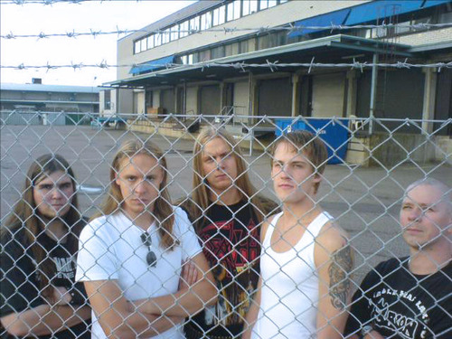
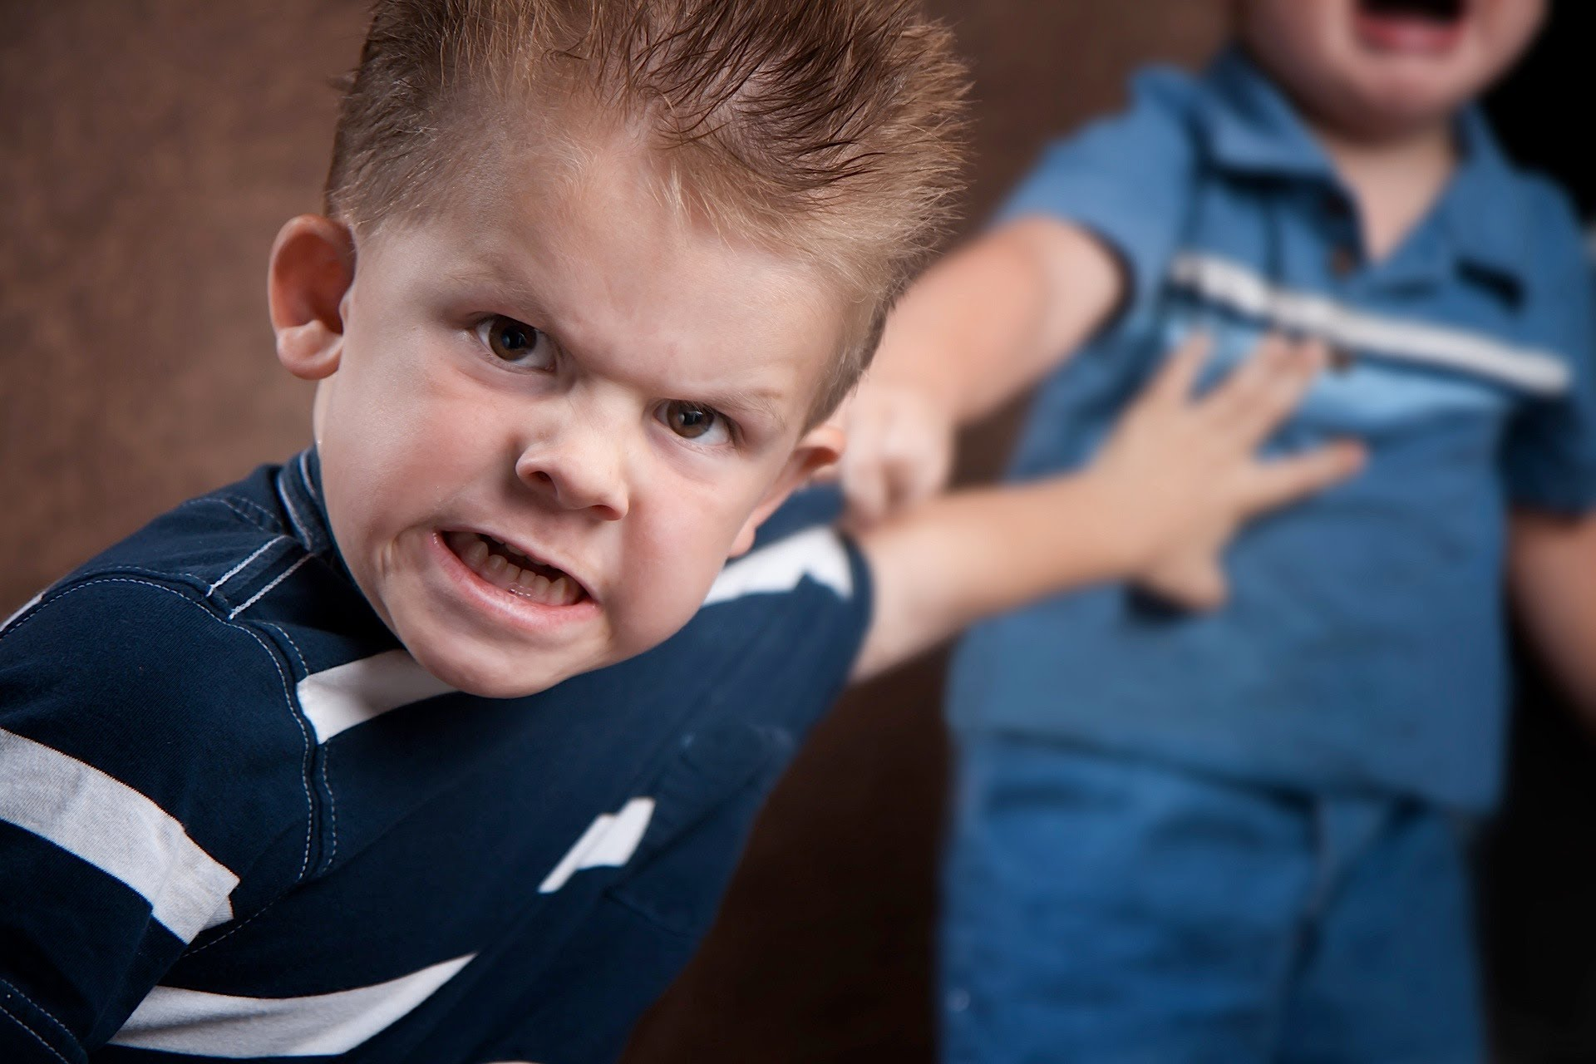
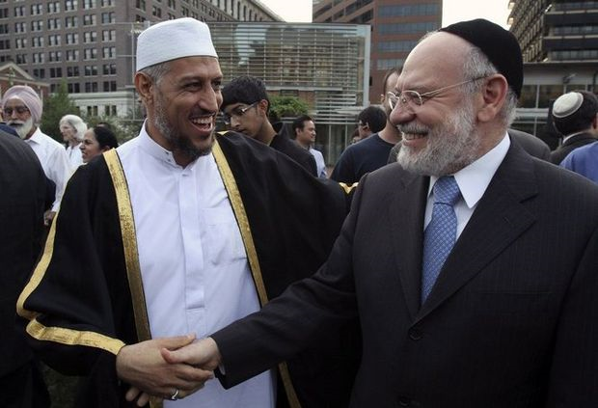
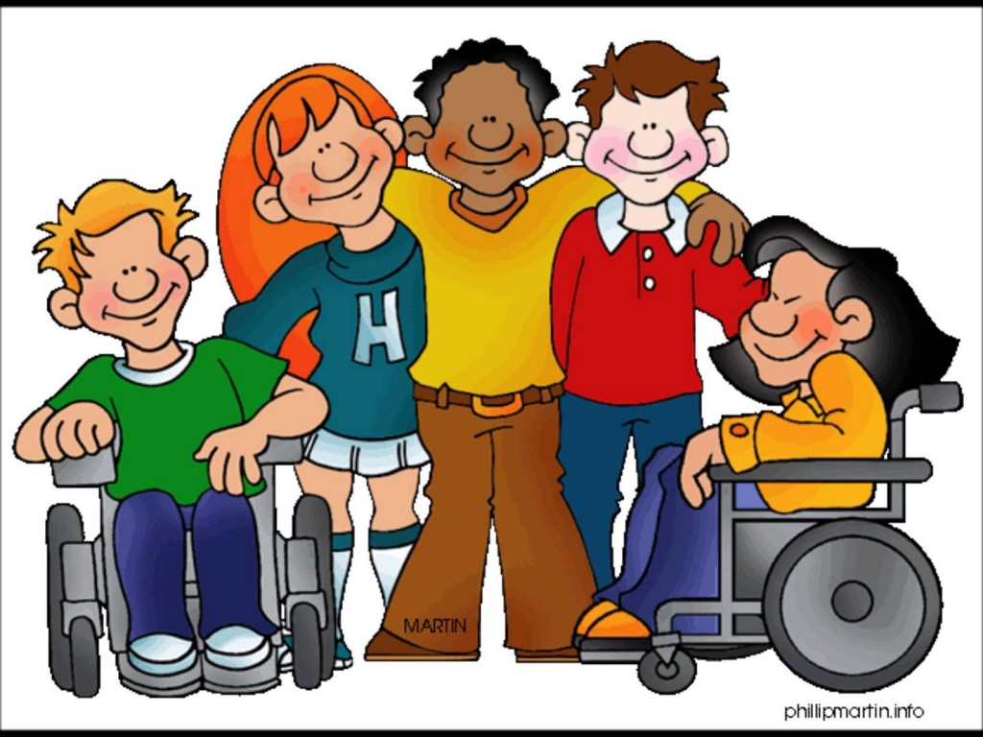

Slide 5
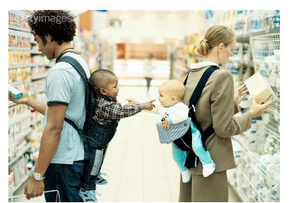
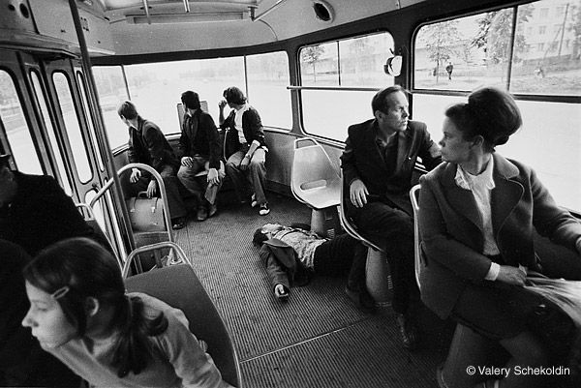
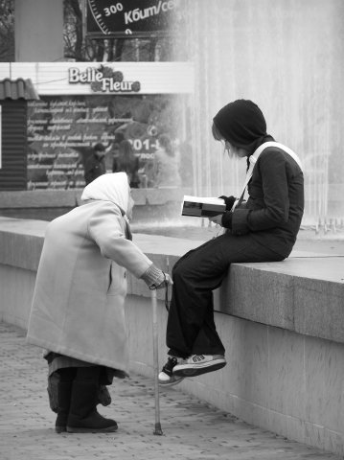

Slide 6
Problem II
To be tolerant – is it good or bad? And to be intolerant?
Can we agree with the statement: “To be tolerant – it is always good, but to be intolerant – it is always bad”? Is it right to be tolerant in any conditions and in all circumstances?
Why?

Slide 7
Task № 2
1. Choose synonyms for the word “tolerance” and words related to it.
2. Choose antonyms for the word “tolerance” and words closest in meaning to “intolerance”.
forebearance bigotry respect contempt
prejudice discrimination sufferance
bias understanding disrespect
indulgence neglect
open-mindedness magnanimity narrow-mindedness

Slide 8
Task № 3
Complete the sentences. Insert a suitable adjectives. Use the words from the task № 2:
1. To be tolerant means to be …, …, … .
2. To be intolerant means to be …, …, … .

Slide 9
Problem III
Should we tolerate the intolerant?
Is it fair to be tolerant to the intolerant?
Do the intolerant has the right to be intolerant? Should we recognize the right of the intolerant to be intolerant?
Has the intolerant the right to complain of intolerance?

Slide 10
Task № 4
There are several quotes: "for" and "against" the tolerance.
Which of these quotes do you agree or disagree with?
Explain and justify your answer (your choice) .

Slide 11
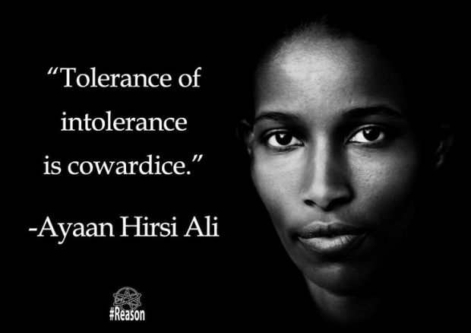
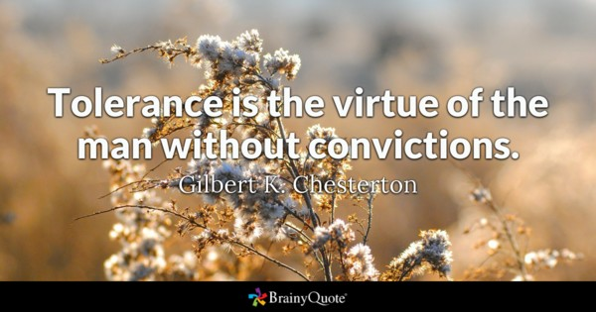
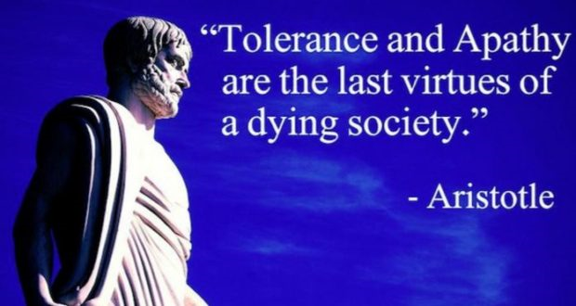
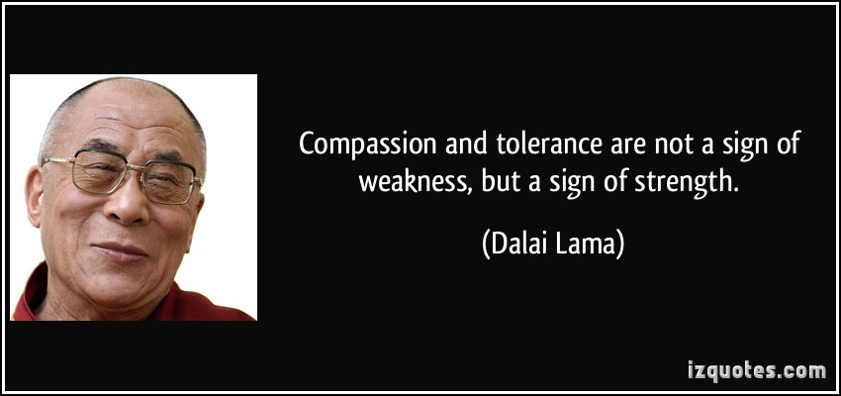

Slide 12
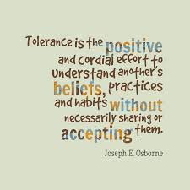
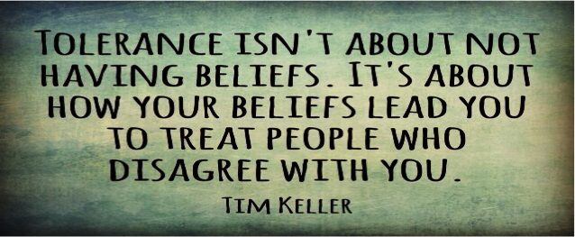
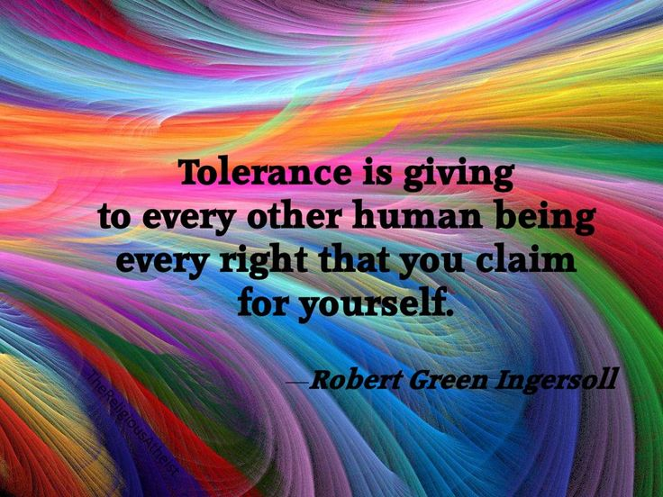
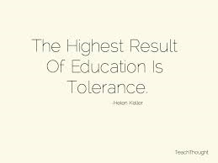

Slide 13
Summary:
What is the tolerance?

Slide 14


