Slide 1
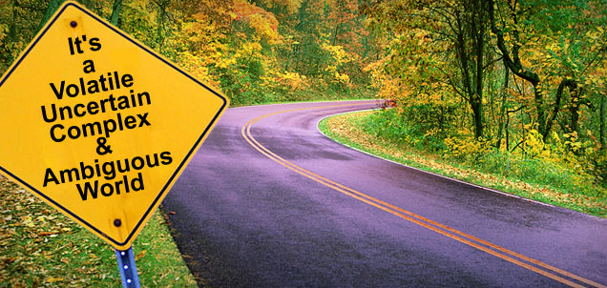
Life and Education in the VUCA-world

Slide 2
The aim of the lecture

Slide 3
What is it?

Slide 4
It is the VUCA-world
https://youtu.be/9yg_BLNSYZU

Slide 5
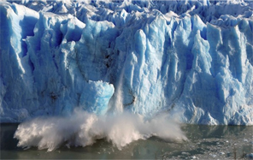
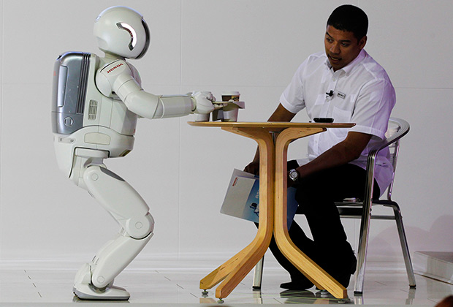
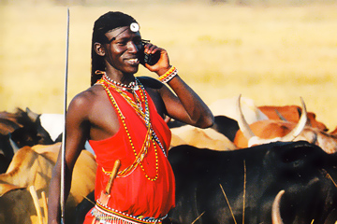
Examples
3
1
2
4
5
Volatility, Uncertainty, Complexity and Ambiguity

Slide 6
To be relevant….
VUCA and COMMUNICATION:
How do we need to communicate to create clarity and connection?
VUCA and ME:
What can I do to create more stability for myself?

Slide 7
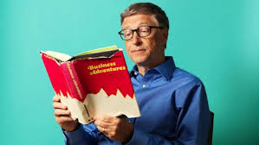
How do you think
Why has the world’s richest person, Bill Gates, read a book a week during his career?

Slide 8
The secret to lifelong success is lifelong learning

Slide 9
LLL includes:
Adult education (second higher education, refresher courses, "freestylers" at university courses).
Trainings (social, strong-willed, intellectual competence of individual training and in groups).
Communication in professional groups (Internet communities, co-working).
Self-study (at home, in libraries, through online courses and applications on the phone).
Travels.
Physical development and sport.

Slide 10
You have…
An hour
A week
A year

Slide 11
Opportunities
Social integration
Personal development
Financial security
…..

Slide 12
Thank you for your attention !
bocharova1305@kspu.ru

