Slide 1
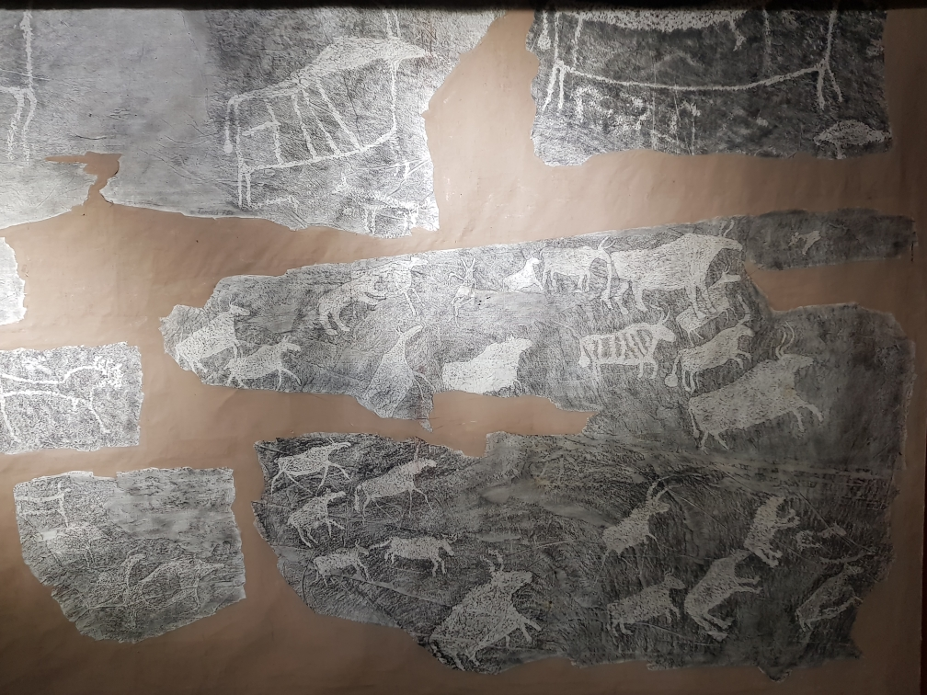
Ethnic groups in Siberia
by Helen Maizik
Postgraduate student of the Department of the National history
Krasnoyarsk State Pedagogical University named after V.P. Astafiev

Slide 2
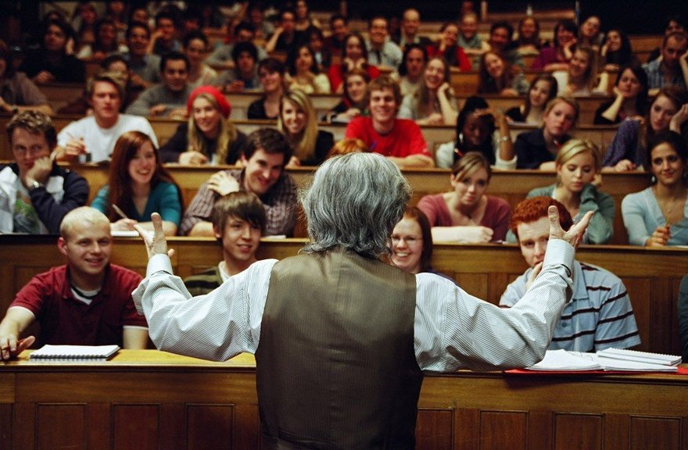
Purposes
a taste of what listening to a university lecture is like
to find out something about the ethnic groups in Krasnoyarsk region

Slide 3
Plan
1. Definition of ETHNIC GROUP
2. South and north aboriginals of Siberia
3. Culture, customs and religion
4. Shamans and shamanism

Slide 4
What is ethnos?

Slide 5
Ethnos
Cultural Anthropology. A population group regarded as having a common descent, or having a common national or cultural tradition
https://en.oxforddictionaries.com
Genesis
Language
Culture
Economy
Territory
Consciousness
Appearance
Mindset

Slide 6
Siberia is a multinational region
Chukchis
Yakuts
Yukagirs
Dolgans
Evenks
Evens

Slide 7
Ethnic groups in Russia

Slide 8
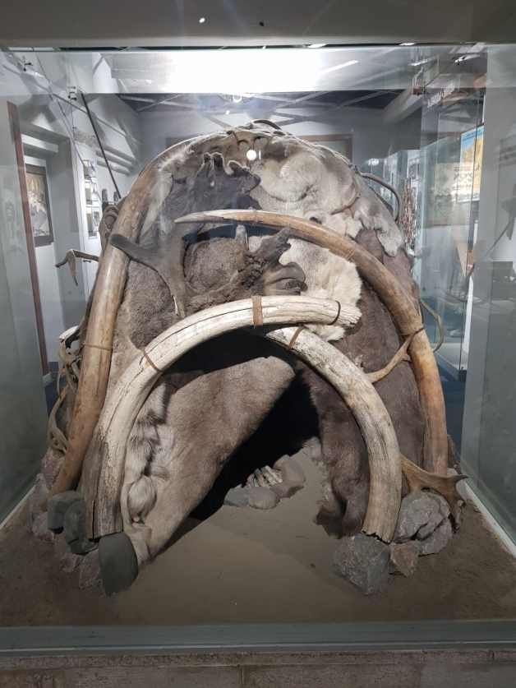
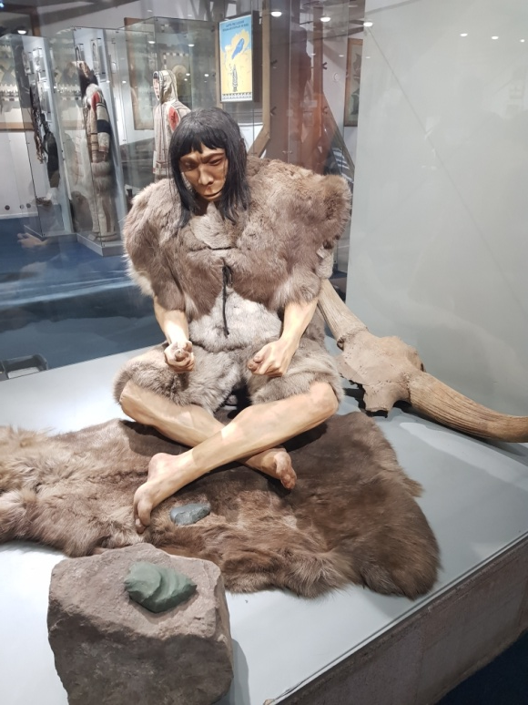
First people in Siberia
Stone strickles
Krasnoyarsk Regional Museum of Local Lore

Slide 9
Bronze boiler of Tagarskaya culture. VII – III B.C.
It was found in Novoselovsky region near Bolshaya Tes village
Krasnoyarsk Regional Museum of Local Lore

Slide 10
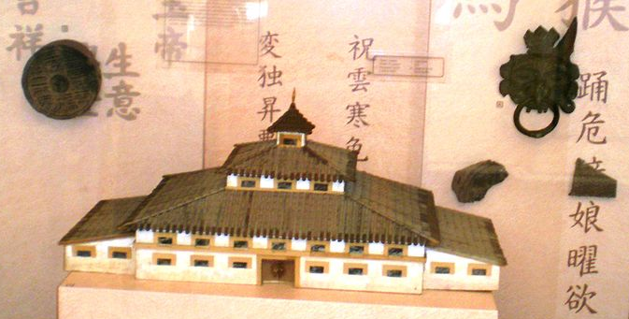
from the Minusinsk Local History Museum named after Nikolay Martianov and the Krasnoyarsk Regional Museum of Local Lore
Bronze mask
model and picture of Hun governor palace, Ist century B.C. Requisition

Slide 11
Have you ever been to Krasnoyarsk Regional Museum of Local Lore?

Slide 12
Map of aboriginals of Krasnoyarsk region

Slide 13
Language characteristic
1. Turkic speaking folks – khakases, yakuts and dolgans
2. Tungus and Manchurian folks – evenks
3. Samodyisk folks – nenets, enets, nganasans, selkups
4. Ketic speaking folks – kets

Slide 14
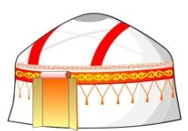
Do you know names of the national dwellings?
wigwam
icehouse
1
3
choom
2
hut
yurt
4
5

Slide 15
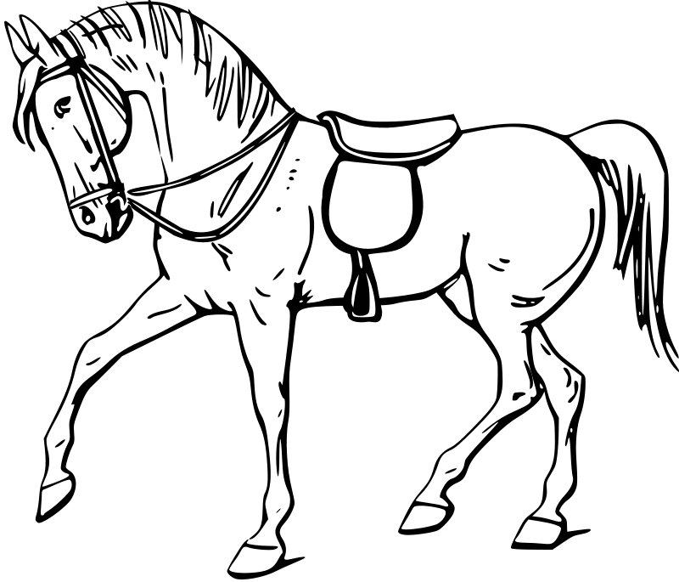
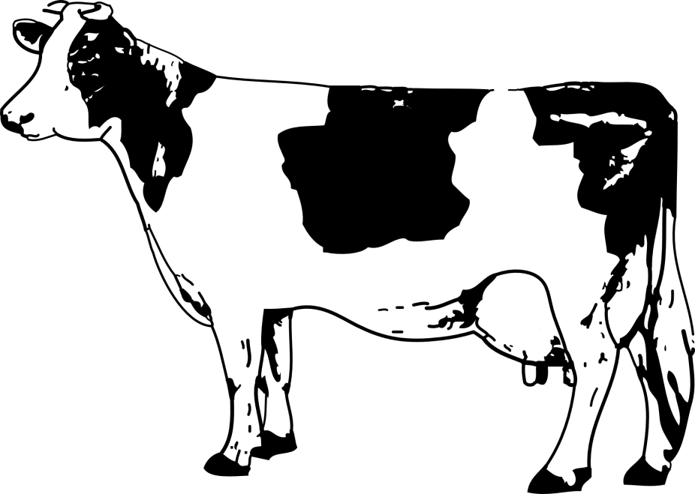
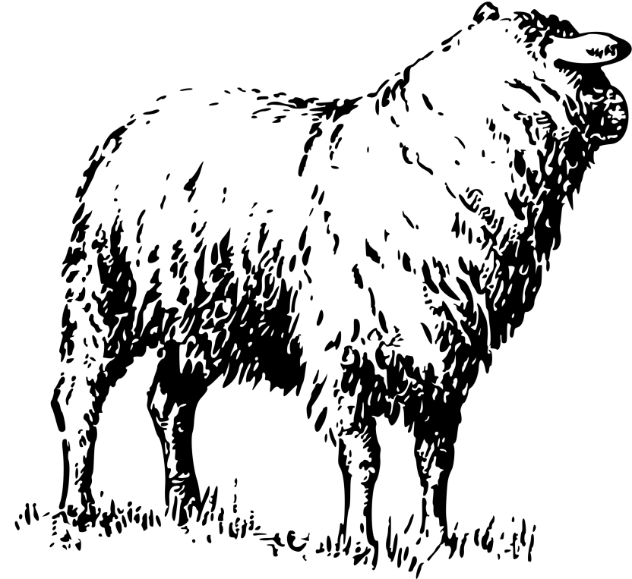
Khakass
Khakasses yurta (nomad’s tent)
from the Krasnoyarsk Regional Museum of Local Lore

Slide 16
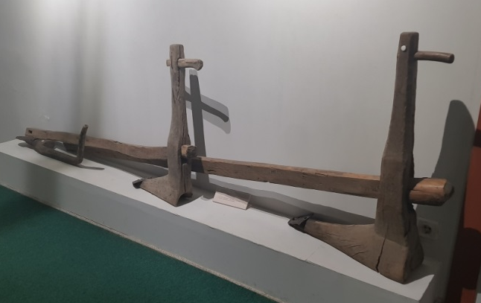
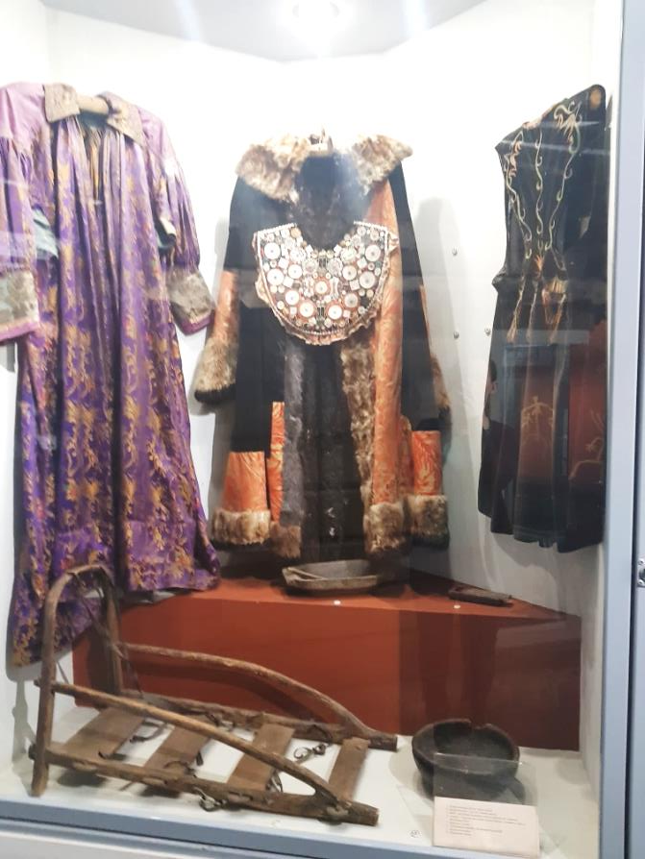
Khakass culture
from the Khakass National Museum of Local Lore and
the Krasnoyarsk Regional Museum of Local Lore

Slide 17
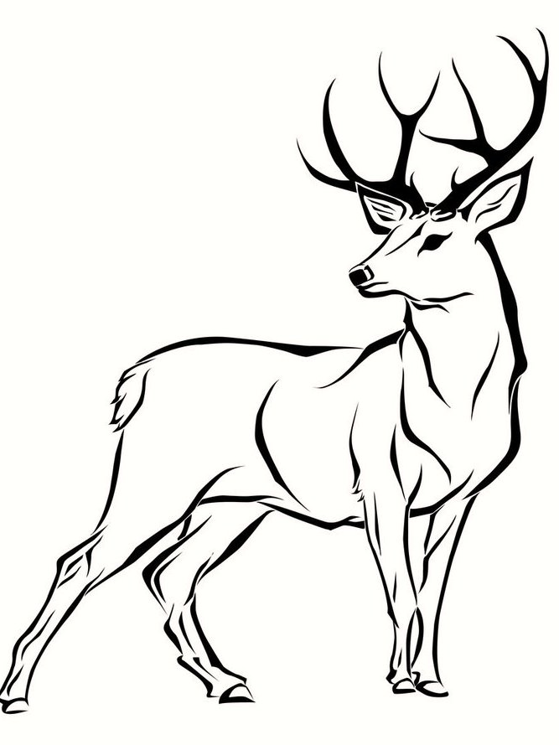
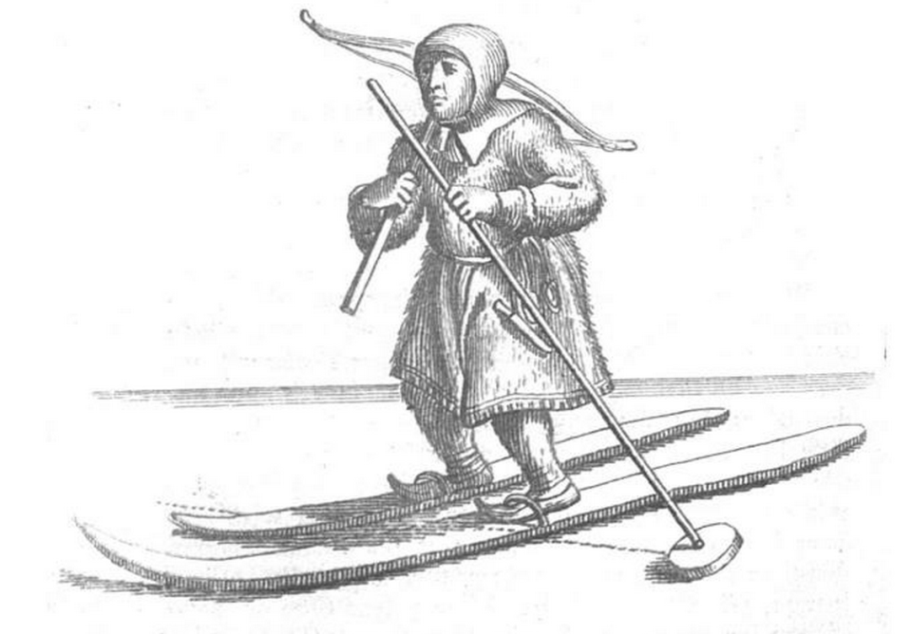
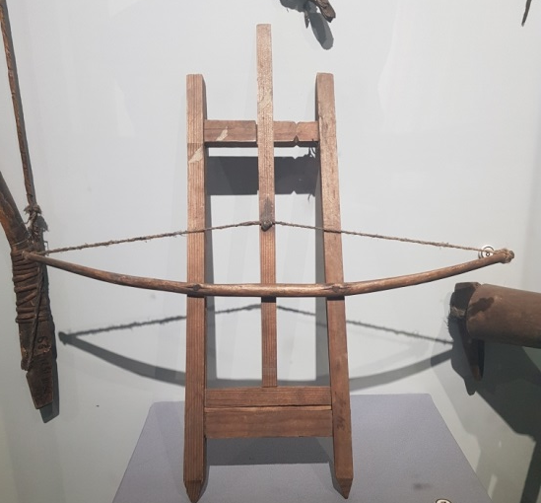
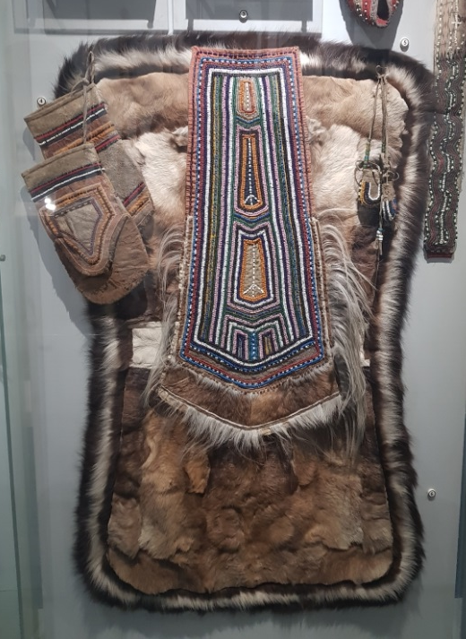
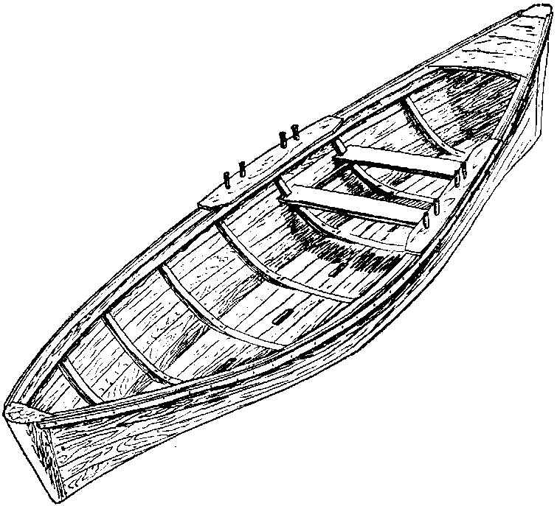
Selkups

Slide 18
Evenks
Reconstruction of Evenk habitation (dyu)

Slide 19
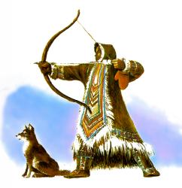
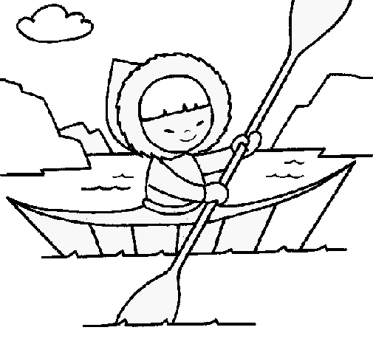
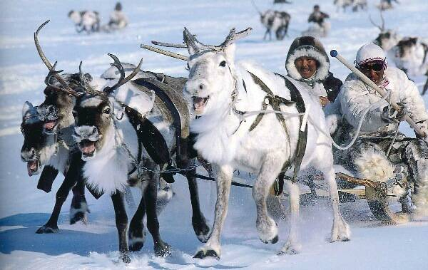
Evenks culture

Slide 20
Nenets, Enets
Nenets are the moat numerous people living in the North of Russian Federation who speak Samoyedie language (34 000 people)

Slide 21
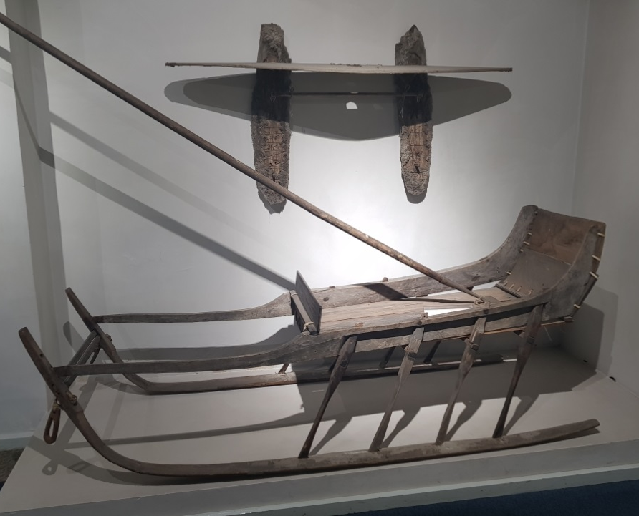
Nenets and Enets economic
Deer farming, hunting and fishing were the principle of the Nenets and Enets existence.
70 – 100 deer heads herd provided the family with all the necessary things

Slide 22
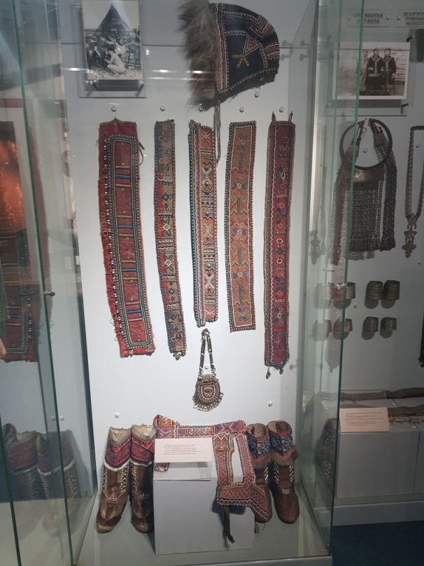
Dolgans

Slide 23
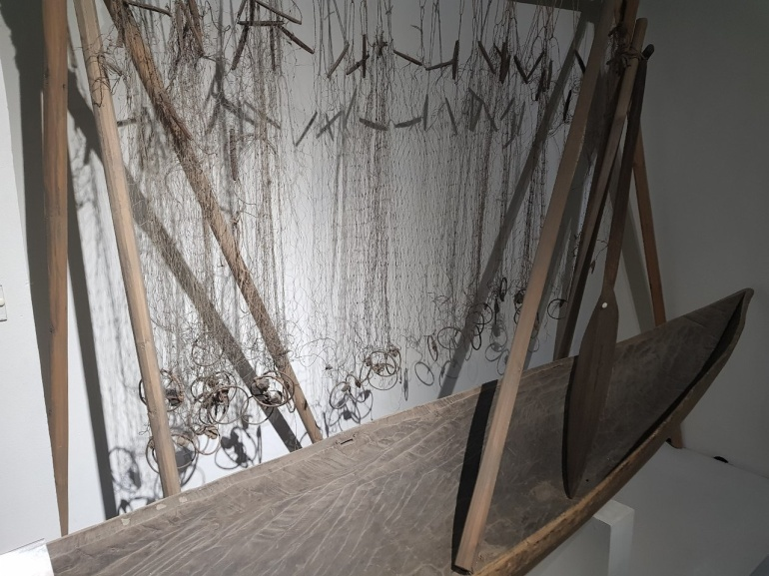
Kets

Slide 24
Shamans and shamanism of the folks living in Krasnoyarsk region

Slide 25
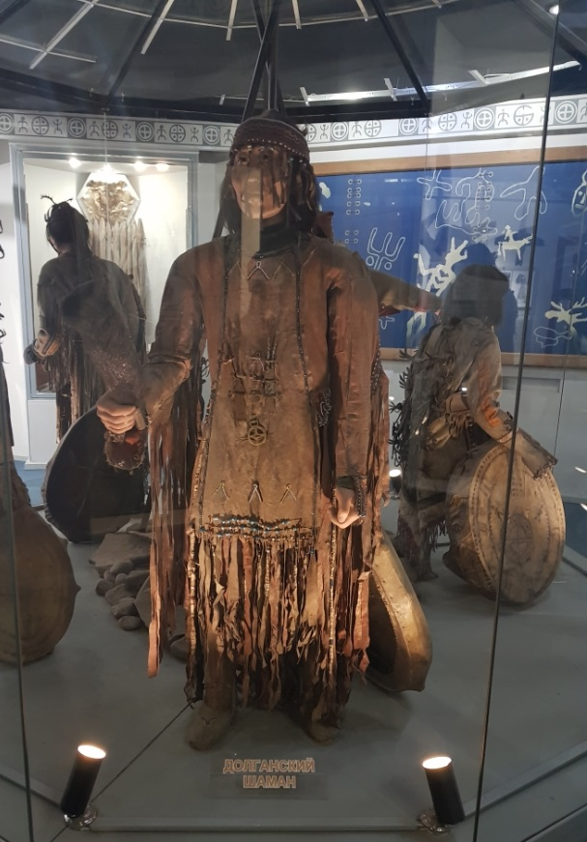
Shamanism is a form of religion and worship, whish main idea is belief in necessity of existence of particular mediators between human groups and spirits
Khakass shaman
Selkup shaman
Dolgan shaman

Slide 26
Shaman tabrets
Tabret is a special musical instrument, which was, like all the other shamanistic attributes, considered to be sacramental, was an obligatory attribute for shamans
Tabret served as a representation of the artistic culture of the people it was used by

Slide 27
Thank you for your attention!

